Slide 1

Evolution of messaging systems and event driven architecture
Suresh Pandey
Notes:
Template version: 11/20/2012, for PowerPoint 2007 & 2010

Slide 2
Topics to Cover
Messaging Overview
Java Messaging System
Advanced Messaging Queuing Protocol
RabbitMQ architecture
Evolution of Kafka
Kafka Architecture and Design
Scalability and Performance
Kinesis Overview
Kinesis vs. Kafka
Sources

Slide 3
Messaging overview
Asynchronous mode of communication.
Sender & Receiver interact through message broker.
Messages in queue stored until the recipient retrieves them.
Implicit or Explicit Limits on size of data transmitted in a single message and the number of messages that may remain outstanding on the queue.
Point to point system without messaging
Loan Processor
Credit Policy
Underwriting
Funding

Slide 4
Loan Processor prime
Loan Processor sub-prime
Adding new system requires p2p connection with all existing systems
Credit Policy
Underwriting
Funding
Error prone and difficult to integrate with new systems
Easier to integrate new systems by using BUS architecture
Loan Processor Prime
Loan Processor Sub-Prime
Less connection to be maintained by each application
Asynchronous processing
Credit Policy
Underwriting
Funding

Slide 5

Java Messaging System (JMS)
Java Message
Producer
JMS API
OpenWire
ActiveMQ
OpenWire
Java Message Service (JMS) is an application program interface (API) specs from Sun Microsystems
Java Message Consumer
JMS API
Notes:
Can easily replace ActiveMQ with any other JMS compliant broker (IBM mq,HornetQ from JBoss) with little or no changes.
Instead of OpenWire, you would than be using the native protocol for HornetQ or IBM mq.
Within the java platform the protocol used by messaging broker doesn’t matter

Slide 6
Java Message
Producer
Java Messaging System (JMS)
JMS API
OpenWire
ActiveMQ
A limitation of JMS is that the APIs are specified, but the message format is not JMS has no requirement for how messages are formed and transmitted.
Essentially, every JMS broker can implement the messages in a different format. They just have to use the same API
OpenWire
Java Message Service (JMS) is an application program interface (API) specs from Sun Microsystems
Java Message Consumer
JMS API

Slide 7
Java Message
Producer
Java Messaging System (JMS)
JMS API
OpenWire
ActiveMQ
STOMP
Ruby can’t use JMS , you need a message broker that can bridge the two platforms and transform the protocol and message structure used by each platform
Supports both STOMP and JMS simultaneously
ActiveMQ contains built-in message bridge for JMS to STOMP and vice versa conversion
Ruby Message Consumer
STOMP CLIENT
Notes:
Issues:
First, both protocol may not support the same message body types
Second, you would essentially be locked into one specific vendor solution
Finally, both protocol may not support the same data types, custom properties and header properties
While cross-platform interoperability is certainly possible, it is restrictive, limited and forces vendor lock-in

Slide 8
Java Message
Producer
Advanced Message Queuing Protocol (AMQP)
RabbitMQ Client
AMQP
AMQP Broker
RabbitMQ
AMQP
Solve the problem of messaging interoperability between heterogeneous platforms by defining standard binary level protocol.
By defining a wire-level protocol standard for messaging , AMQP creates a message-based interoperability model that is completely client API or server (message broker) agnostic
As long as you are using AMQP you can connect and send messages to any AMQP message broker using any AMQP client
Ruby Message Consumer
Qpid client

Slide 9
Traditional architecture
Single Point of Failure
Server1
Consumer 1
Server2
Highly Available
LOAD BALANCER
PRODUCER
Server3
Scalable
Consumer 2
Server4
Performance

Slide 10
RabbitMQ
AMQP Producer
▸ Widely deployed open source message broker based on
AMQP
▸ Distributed broker, provide cluster for load balancing.
▸ High Availability(HA) mode by mirroring queues.
▸ Supports fully transactional communication between clients
and brokers using acknowledgements.
▸ Great support in Spring framework.
N1
N2
N3
AMQP Consumer
Notes:
Widely deployed open source message broker based on AMQP.
▸ Distributed broker, provide cluster for load balancing.
▸ High Availability(HA) mode by mirroring queues.
▸ Supports fully transactional communication between clients and brokers using acknowledgements.
▸ Great support in Spring framework.
▸ focused on consistent delivery of messages to consumers

Slide 11
RabbitMQ Architecture
Smart broker / dumb consumer model
1
Publishers send messages to exchanges, and consumers retrieve messages from queues
2
RabbitMQ cluster distributes queues for the Read/Write load distribution.
3
High Availability(HA) mode by mirroring queues.
4

Slide 12
Single point of failure
Highly Available
Performance
Scalable
Q1 Master
LB
Q2 Mirrored
EXCHANGE
Q3 Mirrored
Producer
Node 1
Consumer
Q2 Master
Q1 Mirrored
EXCHANGE
Q3 Mirrored
Node 2
Q3 Master
Q1 Mirrored
EXCHANGE
Q2 Mirrored
Node 3
Notes:
12

Slide 13

Kafka
Producer: Application that sends the messages.
Consumer: Application that receives the messages.
Topic: A Topic is a category/feed name to which messages are stored and published.
Topic partition: Kafka topics are divided into a number of partitions. Partitions allow you to parallelize a topic by splitting the data in a Kafka particular topic across multiple brokers.
Replicas A replica of a partition is a "backup" of a partition. Replicas never read or write data. They are used to prevent data loss.
Consumer Group: A consumer group includes the set of consumer processes that are subscribing to a specific topic.
Offset: The offset is a unique identifier of a record within a partition. It denotes the position of the consumer in the partition.
Cluster: A cluster is a group of nodes i.e., a group of computers.

Slide 14
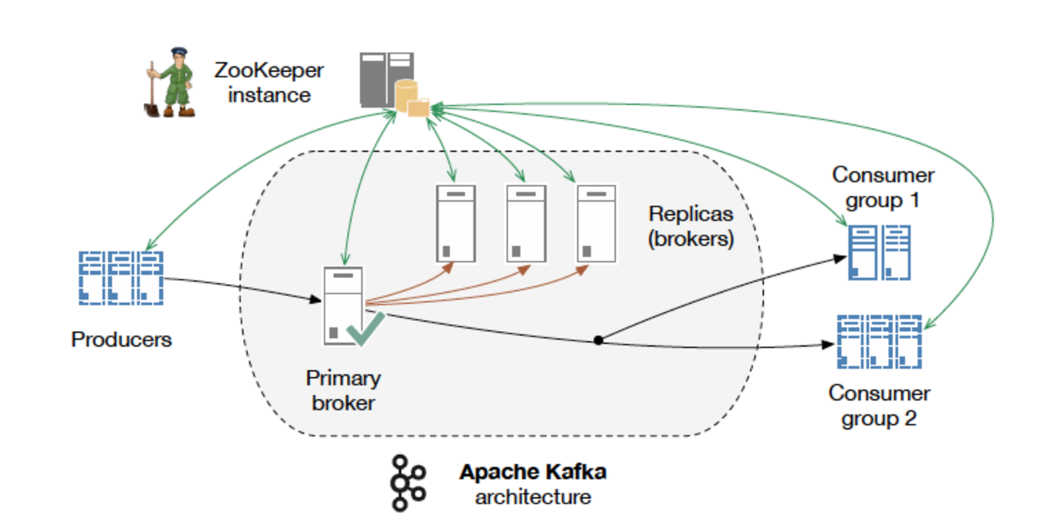
Kafka employs a dumb broker smart consumers model.
Kafka broker does not attempt to track which messages were read by each consumer.
Kafka retains all messages for a set amount of time, and consumers are responsible to track their location in each log

Slide 15
Kafka Message Log
For each topic, the Kafka cluster maintains a partitioned log
Partition 0
0
1
2
3
4
5
6
7
8
9
10
11
12
Partition 1
0
1
2
3
4
5
6
7
8
9
Partition 2
0
1
2
3
4
5
6
7
8
9
10
11
WRITES
Partition 3
0
1
2
3
4
5
6
7
8
Older
Newer

Slide 16
Topic A, Partition 0
Topic A, Partition 1
Consumer Groups
Topic B, Partition 1
Consumer : Topic A
Consumer Group X
Producer 1
Node 1
Topic B, Partition 0
Producer 2
Consumer : Topic B
Consumer Group Y
Topic A, Partition 2
Topic B, Partition 2
Node 2
Notes:
16

Slide 17
Topic A, Partition 0
Topic A, Partition 1
Consumer : Topic A
Rebalancing Consumer
Groups
Topic B, Partition 1
Consumer Group X
Producer 1
Consumer : Topic A
Node 1
Topic B, Partition 0
Consumer : Topic B
Producer 2
Topic A, Partition 2
Topic B, Partition 2
Consumer : Topic B
Consumer Group Y
Node 2
Consumer : Topic B
Notes:
17

Slide 18
Consumer : Topic A
Consumer Group Z
Topic A, Partition 0
Topic A, Partition 1
Consumer : Topic A
Rebalancing Consumer
Groups
Topic B, Partition 1
Consumer Group X
Producer 1
Consumer : Topic A
Node 1
Topic B, Partition 0
Consumer : Topic B
Producer 2
Topic A, Partition 2
Topic B, Partition 2
Consumer : Topic B
Consumer Group Y
Node 2
Consumer : Topic B
Notes:
18

Slide 19
Managing Kafka Cluster
Managing Apache Kafka
Monitoring Apache Kafka Brokers failures
Monitoring Disk, CPU and Memory)
Monitoring partition throughput
Migrating Apache Kafka partitions to new nodes
to increase throughput
Upgrading Apache Kafka version
Failing over to a different cluster in a different data-center or availability-zone
Multi-AZ deployment
Managing Zookeeper
Monitoring Apache Zookeeper node failures
Monitoring Disk, CPU and Memory
Apache Zookeeper JVM Tuning
Scaling Zookeeper nodes to increase CPU, Memory and Disk resources
Upgrading Zookeeper version
Multi-AZ deployment

Slide 20
Kinesis
Kafka
Topic
Partition
Broker
Kafka Producer
Kafka Consumer
Offset
Replication
Kinesis
Stream
Shard
N/A
Kinesis Producer
Kinesis Consumer
Sequence Number
Not required
Fully-managed streaming processing service available on Amazon Web Services (AWS).
Easily scalable to match data volume using apis.
Data replication across 3 AZs
Integrated with other AWS services

Slide 21
Scalability: Kafka
Depends on the number of CPU cores, memory, and the performance of the local disks.
To increase the throughput of the system having more partition than nodes, the users have to add more hardware capacity to the cluster and migrate the existing partitions to the newly added resources.
To increase the throughput of the cluster having node equals to partition, one has to add more resources to the existing resources, also known as scaling up.
Apache Kafka holds historical data, users may be required to increase the disk footprint capacity of the cluster.

Slide 22
Scalability: Kinesis
Throughput of each Shard is pre-advertised.
1000 PUT records-per sec or 1MBps of write.
2Mbps or 5-transactions per-sec of read traffic.
In order to increase the throughput of a given Amazon Kinesis stream, more Shards can be added using apis or using AWS console.
The benefit of the Amazon Kinesis throughput model is that the users have a prior knowledge of the exact performance numbers to expect for every provisioned Shard.
Current read limit of 5 transaction-per second limits on how many applications can read from one shard at any given time.

Slide 23
Latency
Kafka
Configured to perform < 1second
Kinesis
Latency in the range of 1-5 seconds. Applications that require < 1-second latency are not an ideal use-case for Amazon Kinesis.
Durability
Kafka
Provides durability by replicating data to multiple broker nodes
Kinesis
Provides the same durability guarantees by replicating the data to multiple availability zones.
Delivery Semantics
Both Apache Kafka and Amazon Kinesis provide at-least-once delivery semantic.

Slide 24
Kafka vs Kinesis: Cost Factor
Managing Kafka
Monitoring Apache Kafka Brokers failures
Monitoring Disk, CPU and Memory)
Migrating Apache Kafka partitions to new nodes
to increase throughput
Tuning Apache Kafka JVM settings
Scaling Brokers to increase CPU, Memory and Disk resources
Upgrading Apache Kafka version
Recovering/Replacing failed Brokers
Failing over to a different cluster in a different data-center or availability-zone
Multi-AZ deployment
Managing Kinesis
N/A handled by Kinesis Service
N/A handled by Kinesis Service
Amazon Kinesis API to add & remove Shard
N/A handled by Kinesis Service
N/A handled by Kinesis Service
N/A handled by Kinesis Service
N/A handled by Kinesis Service
N/A handled by Kinesis Service
N/A handled by Kinesis Service

Slide 25
Sources
http://www.wmrichards.com/amqp.pdf
http://go.datapipe.com/whitepaper-kafka-vs-kinesis-download
http://docs.aws.amazon.com/streams/latest/dev/key-concepts.html
https://aws.amazon.com/kinesis/streams/faqs/

